Slide 1
Older people’s volunteering
(in cultural heritage) issues of diversity and inequality
Bruce Davenport
Media, Culture, Heritage
School of Arts & Cultures

Slide 2
Volunteering - generally
Volunteering is one form of civic participation.
Volunteering is an individual’s activity undertaken by choice, without concern for financial gain and intended to make a difference outside one’s own family.
In the England, approx. 27million adults participated in formal or informal volunteering once in 12months in 2021/22 (Community Life Survey, 2023)
In the UK, participation rates are highest among those aged 65 & over. (NCVO, 2019) but drops off for people over 75.
Volunteering since lockdown – a curious mix of stability and change.

Slide 3
Older volunteers & heritage
Volunteers play an important role in many (majority?) of museums (MDE, 2023)
Many organisations could not deliver their offer without volunteers
Huge diversity in the balance of staff & volunteers
Diversity in volunteer management structures
Older people important group for heritage volunteering.

Slide 4
Cessation of Volunteering
Volunteering ↔ wellbeing
People find they have to stop volunteering even if they don’t want to.
What is the impact of leaving a voluntary role on wellbeing?
  Available evidence suggests negative impact.
What is the impact of managing that process on volunteer managers?
  Negative/difficult
Can the impact of leaving be managed in such a way as to moderate the impact for both volunteers and volunteer managers?

Slide 5
Issues raised through the project
What is the relationship between the volunteer-involving organisation and their (older) volunteers?
Reciprocity is (differently) important to both volunteers and staff – but where do the limits of reciprocity lie?
Does the moral obligation implicit in the idea of reciprocity extend beyond the duration of someone’s involvement?
What are the implications of this for fixed-term engagements (e.g., cultural projects or social prescribing)?

Slide 6
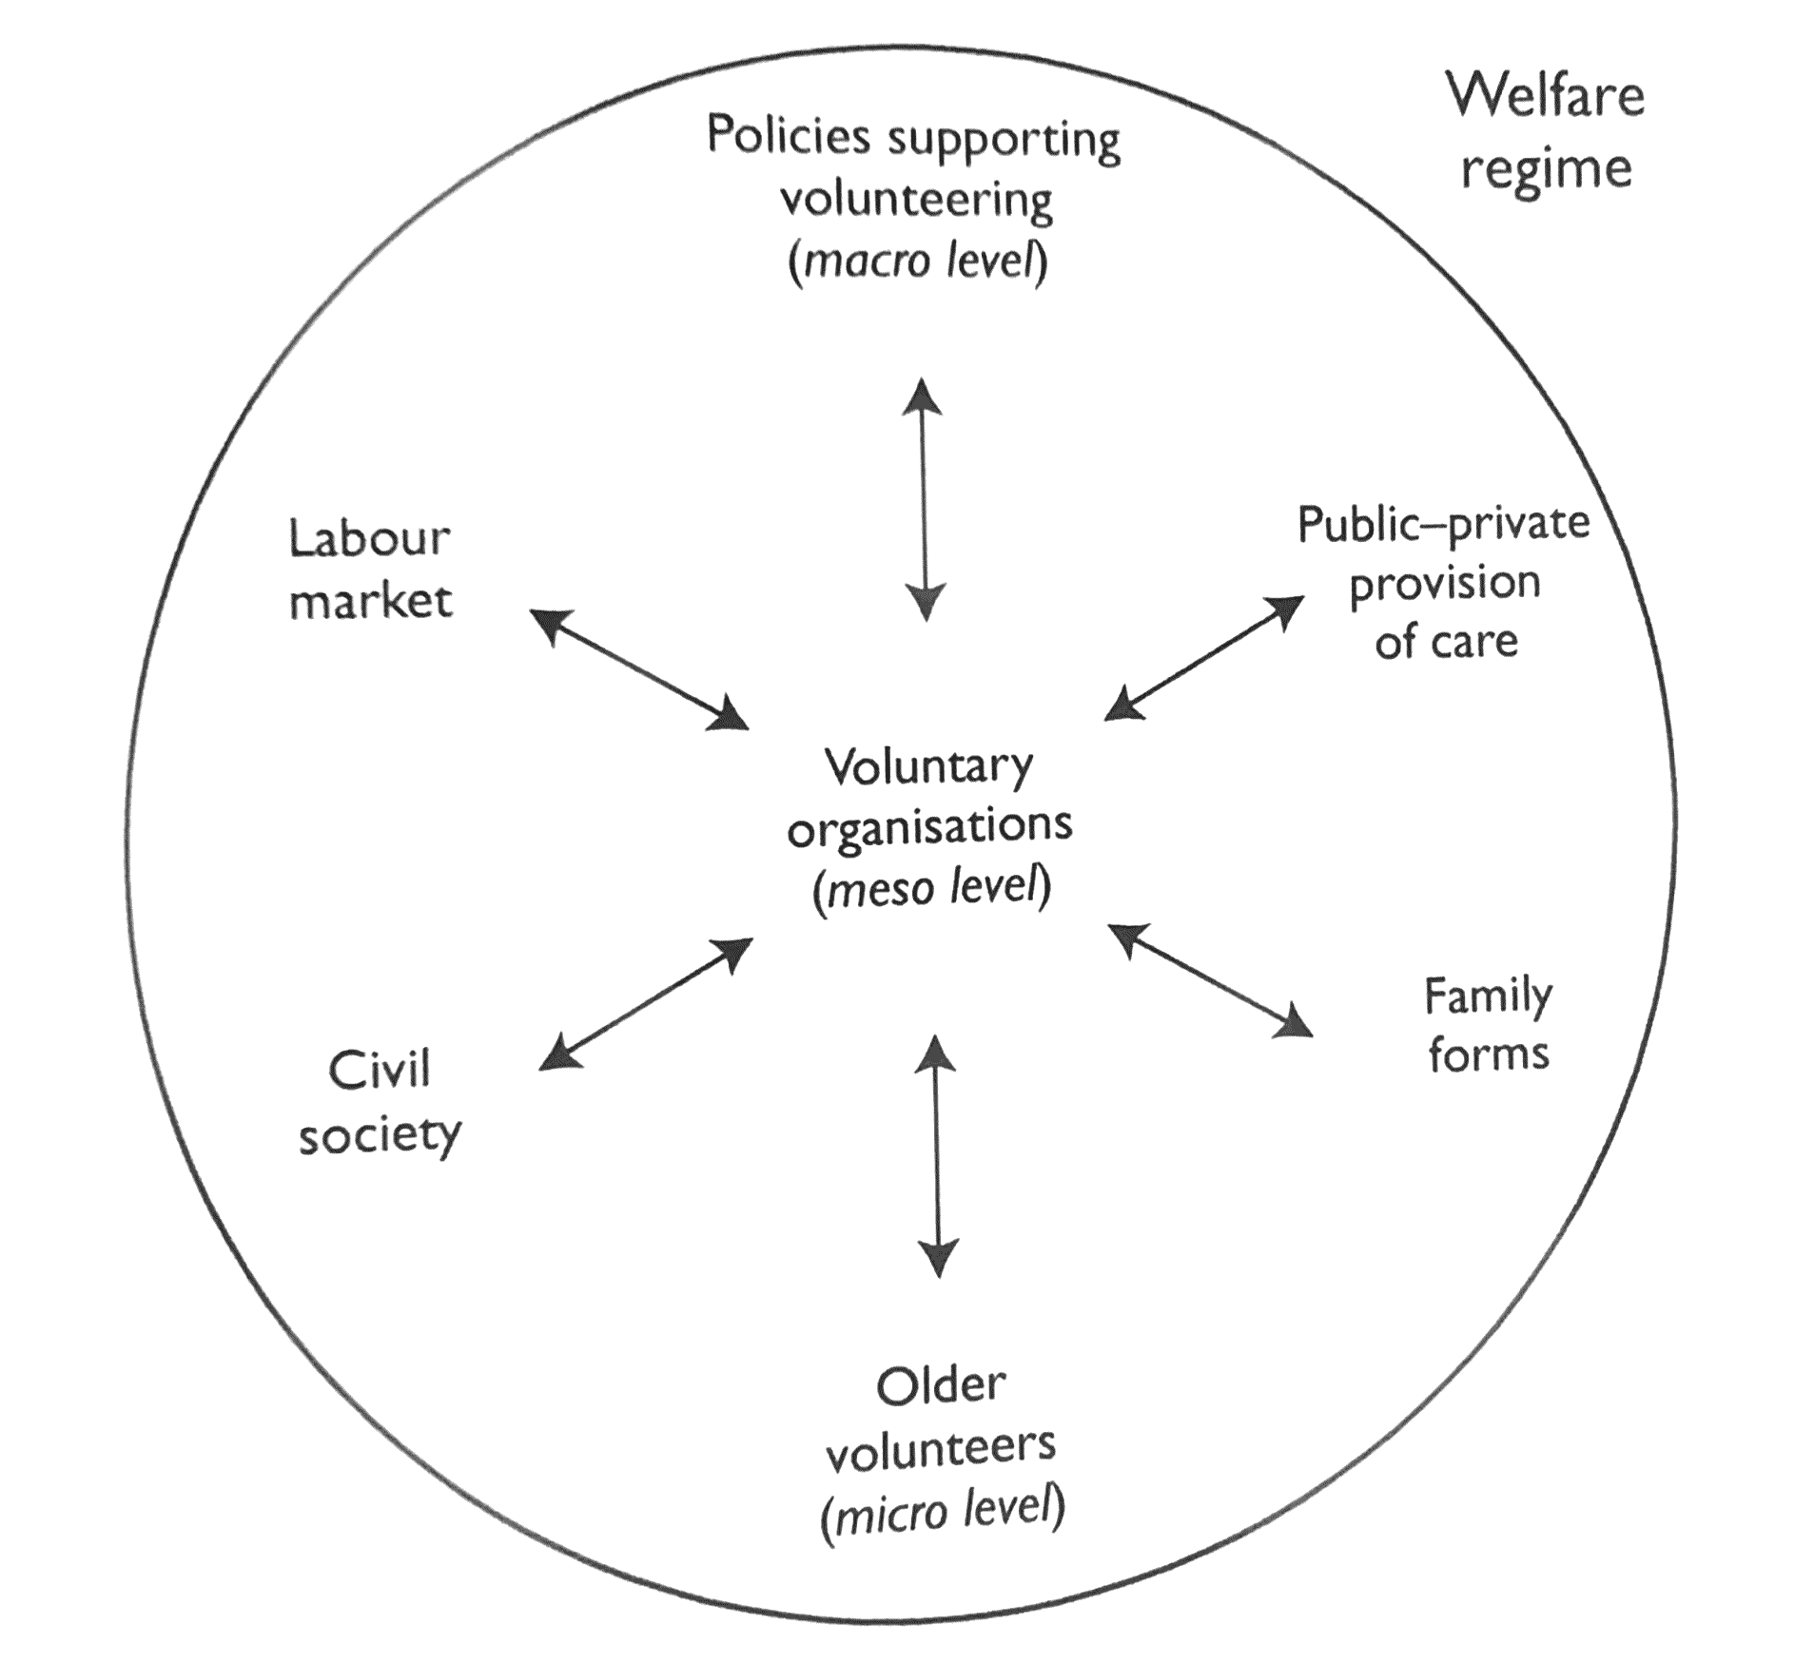
Volunteering – diversity and inequality
There is considerable diversity in who volunteers, who they volunteer with, what they do & why.
Diversity of choice and barriers to involvement
People need to have resources to be involved.
Some barriers have become more salient in recent years - consequence of the cost-of-living crisis.
From Principi, Lamura & Jensen (2014)

